Slide 1
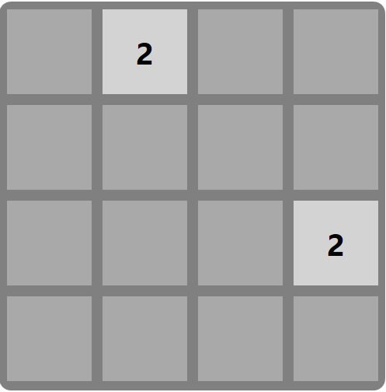
2048
Aaron Borjas, Caleb Grode

Slide 2
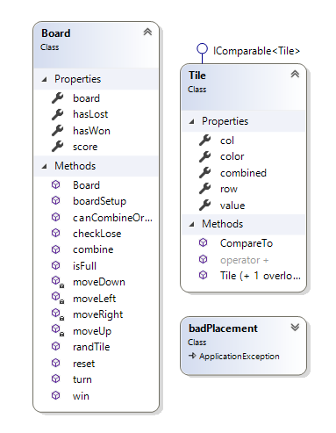
Design
Tile
Color
value
Board
4x4 array of Tile Objects
Driver function “turn” for each arrow key input
Functions to move tiles in the array up/down/left/right
badPlacement
Exception thrown when a tile is randomly generated and placed where another tile already exists in our board

Slide 3
Gameplay
Begin Game “Loop”
Tiles & Score Refreshed
Board Reset
Random tile created on board, loss condition checked
On Arrow Key Pressed
Direction parsed based off key value
Game “Loop”
On Arrow Key Pressed
Tiles moved in direction of key press & combined where applicable

Slide 4

Challenges
numOpen
Fullscreen
Moving
Combining

